Slide 1
Procedures and Design
Statistics for the Behavioral Sciences

Slide 2
Procedures
Indicates how the data were collected
Walks the reader step-by-step on what the researchers did
Walks the reader step-by-step on what the participants did
Can sometimes include the informed consent process

Slide 3
Research Designs
Sets the reader up for the analysis
Different designs require different analyses
What type of variable (nominal, ordinal, continuous)?
How many IV and DV variables?
How many covariates?
How many groups?
Between and within group designs?
Other specialty designs such as meta-analysis

Slide 4
General Analyses
Descriptive
Describe individual variables (how things are)
Demographics, survey questions, etc.
Relational (explanatory)
Examines the relationship among variables
Is marital satisfaction and length of marriage related?
Experimental (causal)
Establishes causation among variables
Requires random assignment to groups

Slide 5
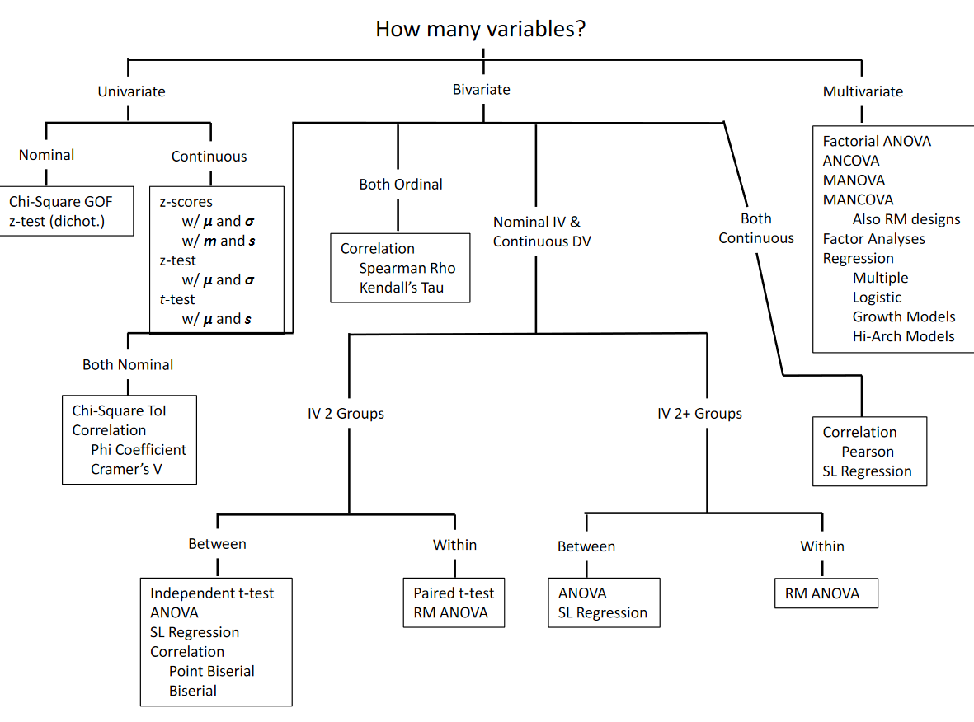

Slide 6
Multivariate
Factorial ANOVA and RM ANOVA
One continuous dependent variable
2+ nominal independent variables
Also summarized (for example, 2 x 3 x 4 ANOVA)
Post-hoc tests
ANCOVA and RM ANCOVA
One continuous dependent variable
1+ nominal independent variables
1+ covariate variables

Slide 7
Multivariate
MANOVA and RM MANOVA
2+ continuous dependent variables
1+ nominal independent variables
MANCOVA and RM MANCOVA
2+ continuous dependent variable
1+ nominal independent variables
1+ covariate variables

Slide 8
Multivariate
Factor and principal components analysis
Several manifest variables to identify latent variables
Commonly used for instrument development
Meta-analysis
Summarizing standardized effect sizes across research studies

Slide 9
Multivariate
Regression analyses
1 continuous outcome (DV)
1+ nominal or continuous predictors (IV)
1+ nominal or continuous covariates
Logistical regression analyses
1 nominal outcome
1+ nominal or continuous predictors (IV)
1+ nominal or continuous covariates

Slide 10
Multivariate
Hierarchical regression analyses
Allows for multiple levels (e.g., students within a classroom within a school within a district within a state)
Growth modeling
Outcome measured multiple time across time
Path-analysis
Multiple variables analyzed in a causal order
Results in multiple models

