Slide 1
ANOVA Introduction
Statistics for the Behavioral Sciences

Slide 2
ANOVA
When to use:
ANOVA
Have only categorical predictors (don’t restrict the range)
Predictor has multiple levels (post-hoc test options)
Are measuring observations multiple times (RM designs)
Need a measure for equal variance assumption

Slide 3
ANOVA
Limitations:
ANOVA
Doesn’t support continuous predictors
No measure of SEE for individuals
Limited to three predictors
Fewer diagnostic options in statistical packages
Interaction post-hocs can be more difficult to calculate

Slide 4
ANOVA
Things to look for in ANOVA-type studies
Correct ANOVA model
Alpha inflation
Correct interaction interpretations
Post-hoc tests
Effect sizes

Slide 5
ANOVA F-Tests
One-way between groups ANOVA
Two-way between groups ANOVA
One-way within groups ANOVA
Mixed model ANOVA

Slide 6
ANOVA
Used to compare 2+ groups (samples)
No population information is known for any group
Typically assume the pop. differences is 0 (H₀)
H₀: μ₁ = μ₂ = μ₃ = μ₄... or H₀: σ²_{µ} = 0
Tests no differences among the group means
Omnibus test – all group means tested simultaneously
Could do multiple t-tests and Bonferroni correction
Inflates alpha (Type I error rate)
Bonferroni correction too conservative with more groups

Slide 7
One-Way ANOVA
An F-test with 2 groups = Independent t-test
Result of the analysis is the same
F-statistic equals the t-statistic squared
If reject the null hypothesis, then
At least one difference among the group means
… but do not know which one(s)
Post-hoc q-tests (essentially multiple t-tests that control alpha inflation)

Slide 8
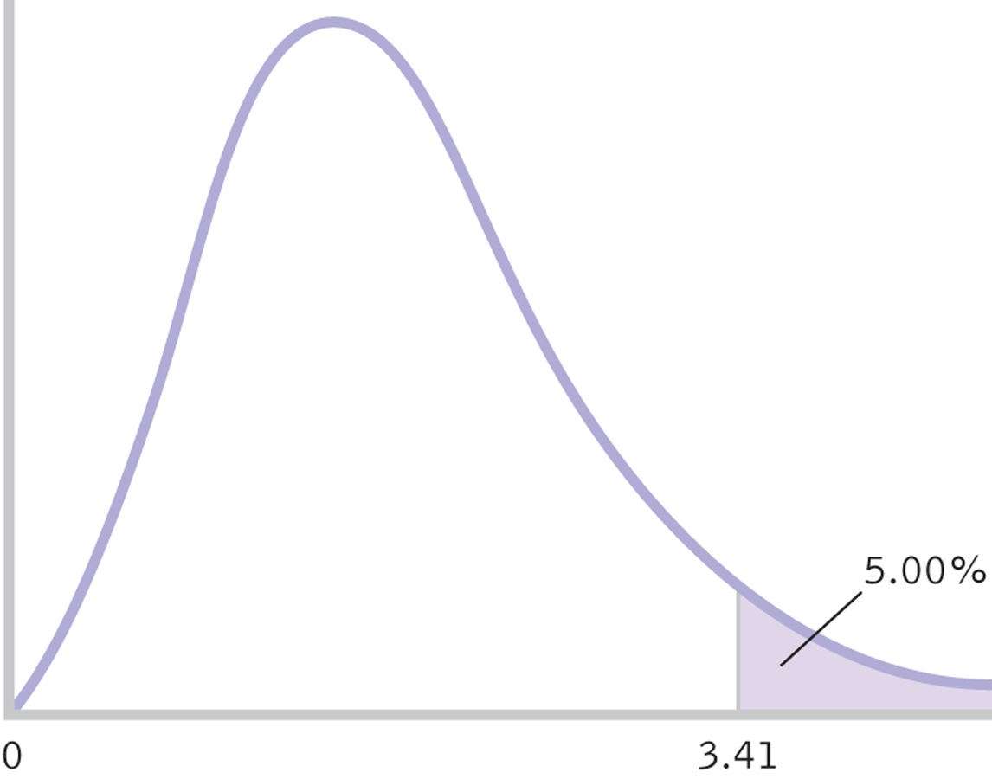
F-Distribution

Slide 9
One-Way ANOVA
“One-way” indicates 1 independent variable
The IV has many levels (conditions, groups, or samples)
Different types of F-tests
Ex. Levene’s test of equal variance
Also based on design
Between, within, mixed, covariate, and multiple dependent variable designs

Slide 10
ANOVA Assumptions
ANOVA assumptions of concern:
Random sample from population of interest
Independence of observations
Normality, if less than 30 observations in a group
N = 30+, we assume a normal distribution (CLT)
Independency of populations
Equal variances among the populations
Assumed equal if sample sizes are equal
Unequal N’s: Congruent = lower α; incongruent = higher α

Slide 11
ANOVA F-Tests
One-way between groups ANOVA
Two-way between groups ANOVA
One-way within groups ANOVA
Mixed model ANOVA

Slide 12
Two-Way ANOVA
“Two-way” indicates 2 independent variables
Each IV has many levels (groups or samples)
Used to compare two independent variables
Results in three general hypotheses
Tests all hypotheses simultaneously on one DV

Slide 13
Two-Way ANOVA
Look at interaction first
If reject the null hypotheses, then
Conduct post-hoc tests

Slide 14
ANOVA F-Tests
One-way between groups ANOVA
Two-way between groups ANOVA
One-way within groups ANOVA
Mixed model ANOVA

Slide 15
F-Tests
Repeated measures design

Slide 16
RM ANOVA Assumptions
RM ANOVA assumptions of concern:
Random sample from population of interest
Independence of observations
Normality, if less than 30 observations in any group (sample)
N = 30+, we assume a normal distribution (CLT)
Dependency of populations (check for correlation)
Equal variances between the populations
Assumed equal if sample sizes are equal

Slide 17
F-Tests
Source table of variation
Source | SS | df | MS | F
Between | SS_{b/t} | df_{b/t} | MS_{b/t} | F-stat
Subjects | SS_{subj} | df_{subj} | MS_{subj} | F-stat
Within | SS_{w/i} | df_{w/i} | MS_{w/i}
Total | SS_{tot} | df_{tot}

Slide 18
ANOVA F-Tests
One-way between groups ANOVA
Two-way between groups ANOVA
One-way within groups ANOVA
Mixed model ANOVA

Slide 19
F-Tests
Mixed model design

